Slide 1









UNI-CORN
Finding Tomorrow's Unicorns Today

Slide 2





we are diverse team of motivates students
TEAM
TH
JW
PS
JD
OH
Tobias Hug
B.Sc. Business Informatics,
Teaching Assistant for Practical CS & Software Engineering
Jannis Wiederhöft
M.Sc. Business Informatics
Paul
Stahl
B.Sc. Business Informatics
Jacob Deitinghoff
B.Sc. Business Informatics
Ole Handschug
B.Sc. Business Informatics,
Data Engineering @Bloomberg, Software Engineering @Check24

Slide 3

Titel
Problem Statement
„I waste too much time every week just doing initial research on startups. Scrolling through websites, cross-checking founders' backgrounds, hunting down basic metrics - all to discover most aren't even remotely aligned with our investment thesis.“
~ anonymous Picus Capital Employee

Slide 4
Challenges
manual-,
fragmented-,
time-intensive-,
VC scouting/evaluation
complex start-ups
overwhelming volume
more available data
BUT:
VC capacity limited
inefficient capacity usage
Difficult or wrong decisions
´

Slide 5


Delivering unique insights
AI-powered platform
discovering,
analysing,
evaluating,
Identifying
Ddd
automated data collection
analysis of potential success
patterns enable consistent scoring

Slide 6



c
Data Collection
Dd
Dd
Ddd

Slide 7
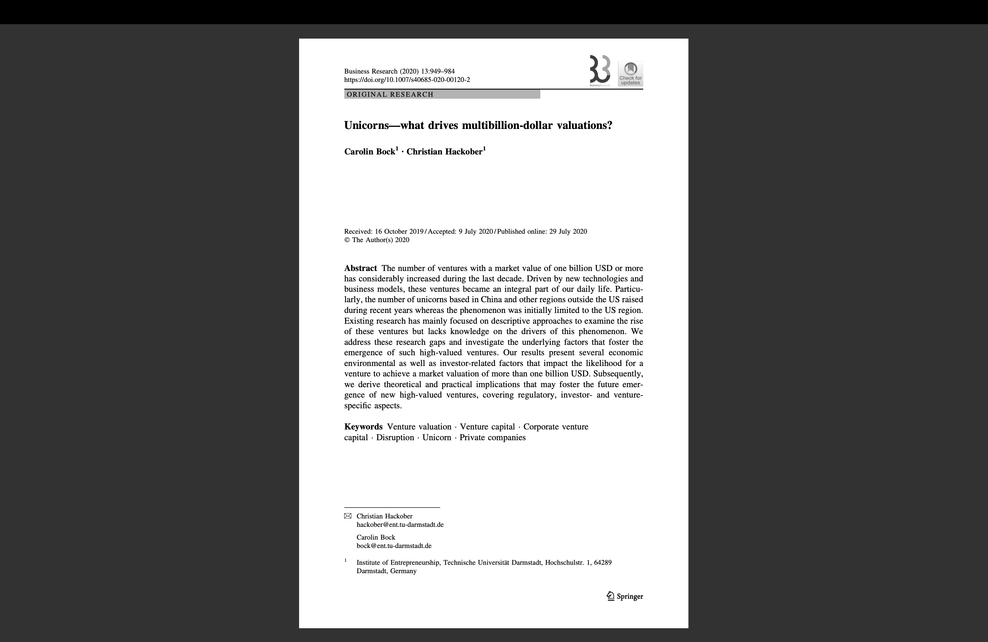
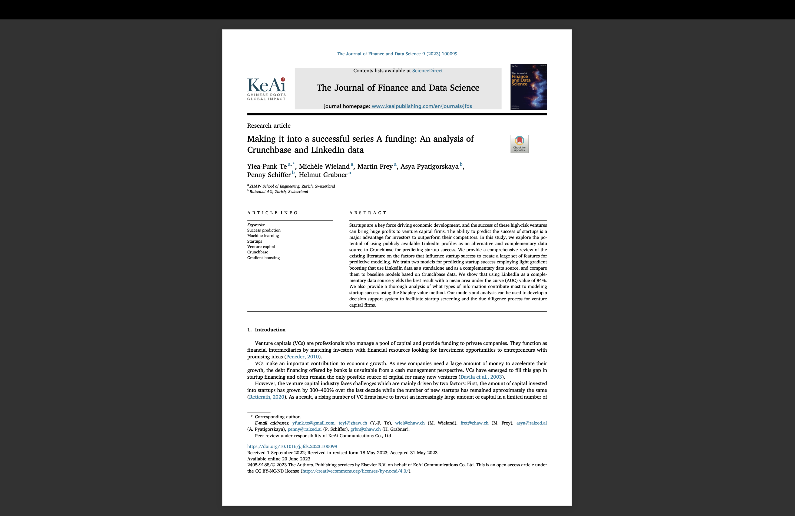
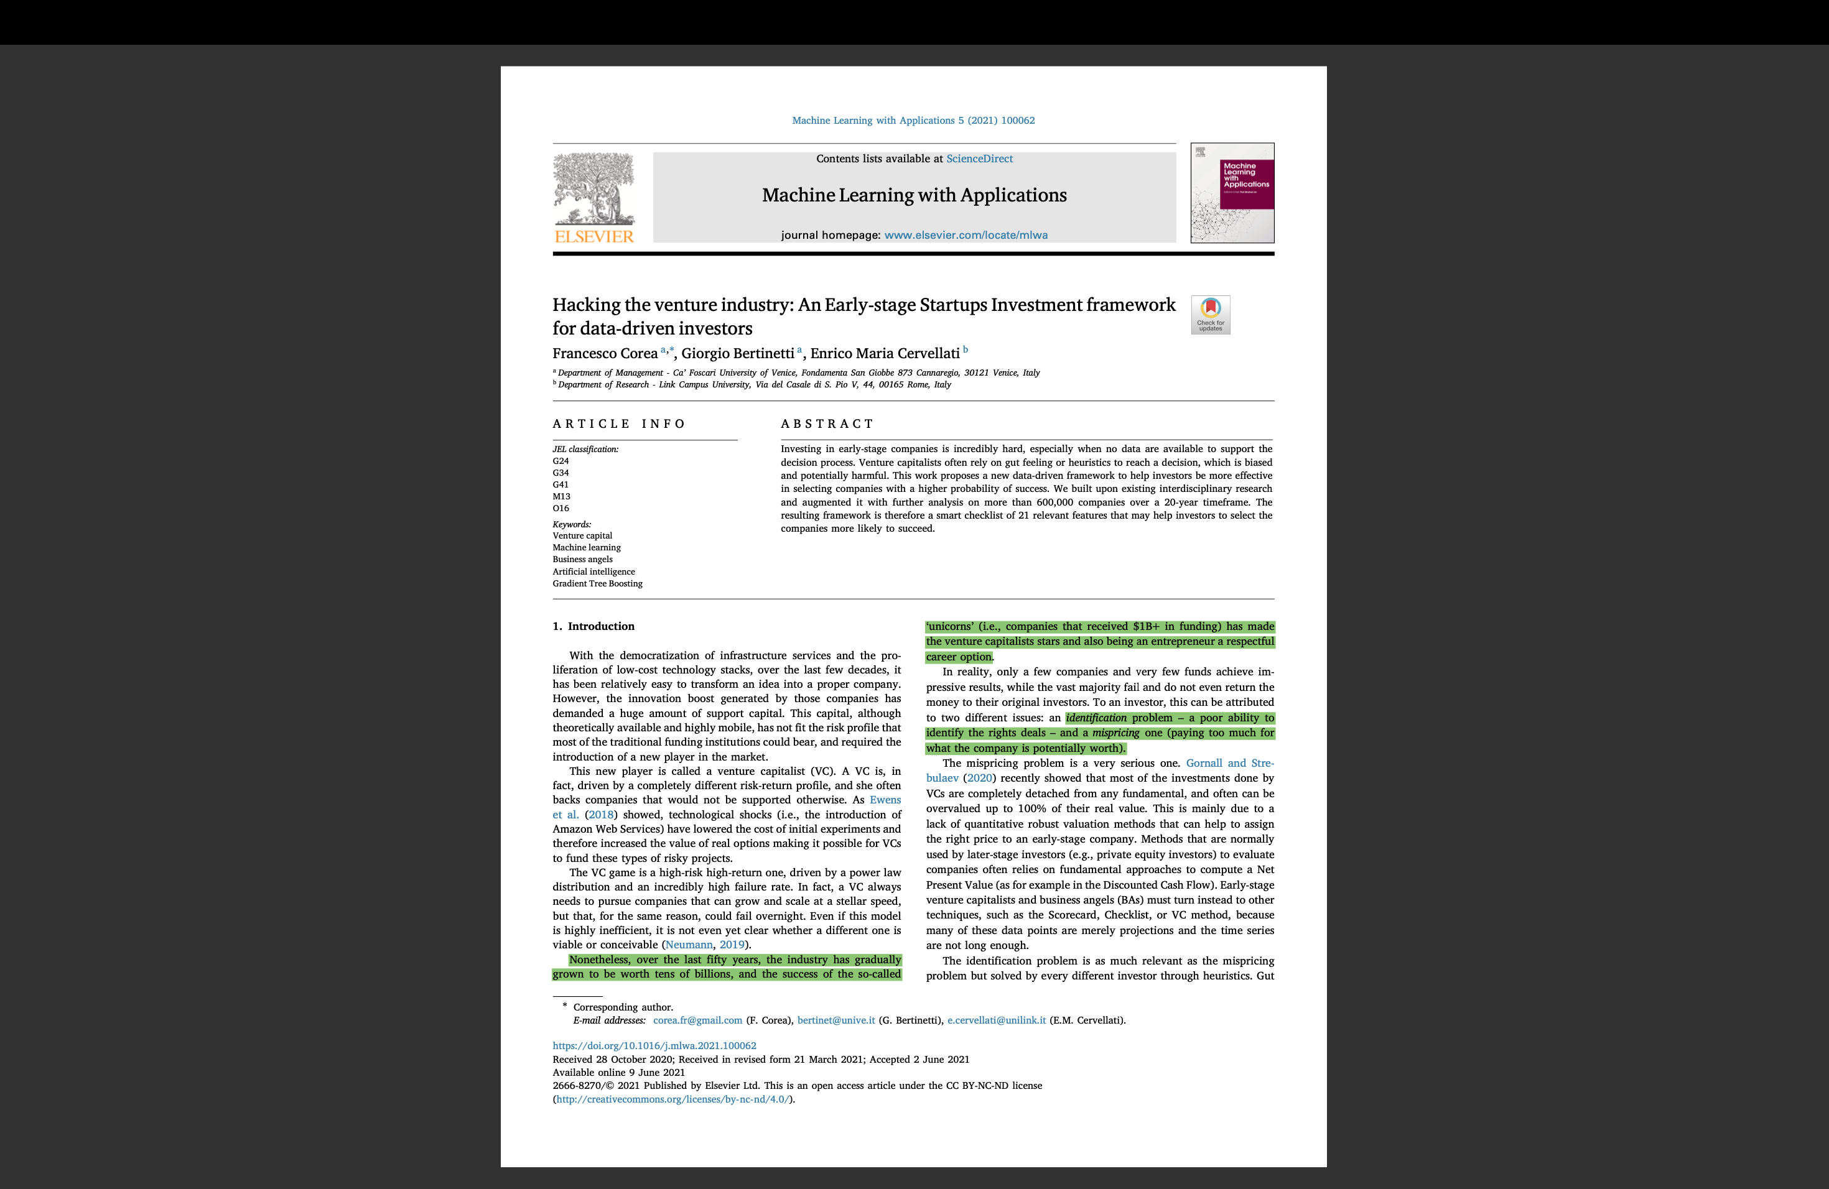
c
Metrics
Dd
Dd
Ddd

Slide 8

c
Metrics Overview
Dd
Dd
Product USP
Sector
Ddd
finBERT
Industries CSV
MRR & ARR
Prev. Employments
Number Heuristics
Companies CSV, Employment
User Engagement
Cap Table
VADER
finBERT & VADER

Slide 9

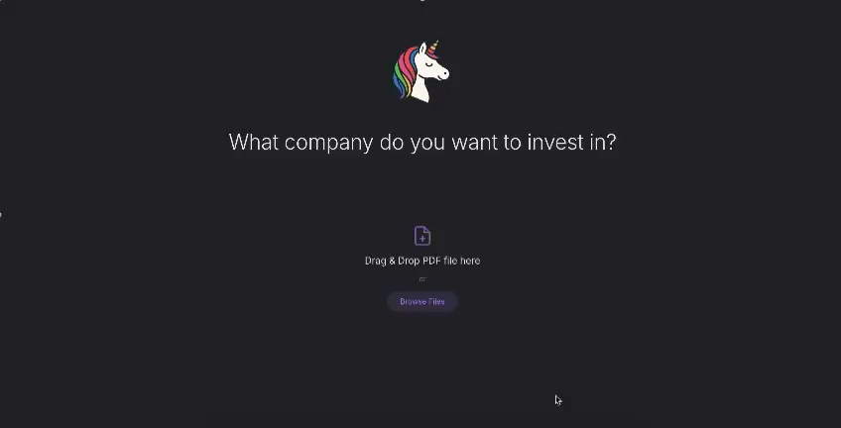
Demo

Slide 10
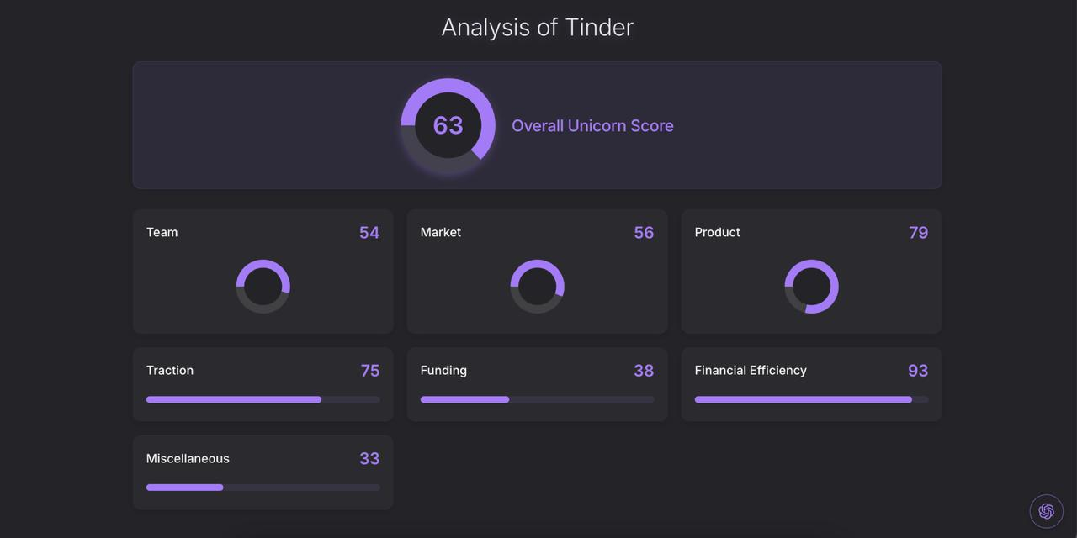
Startup Example 1

Slide 11
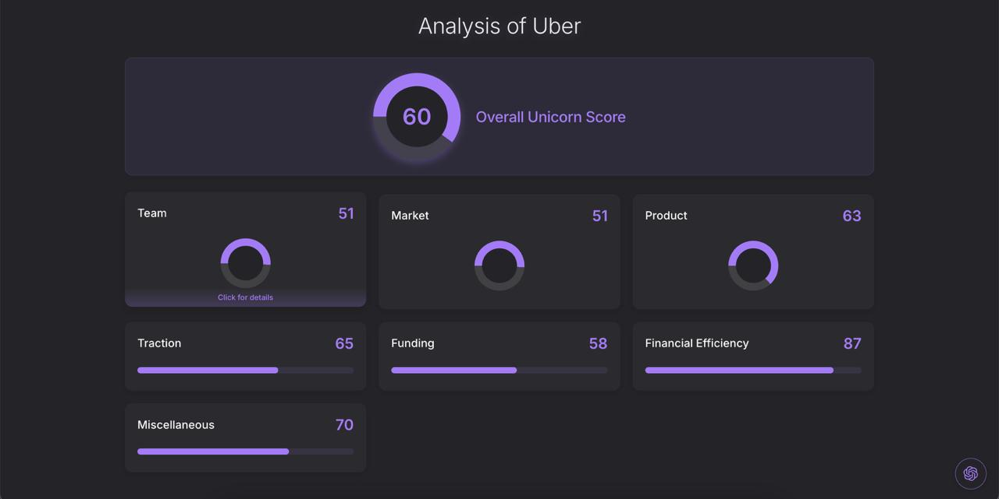
Startup Example 2

Slide 12
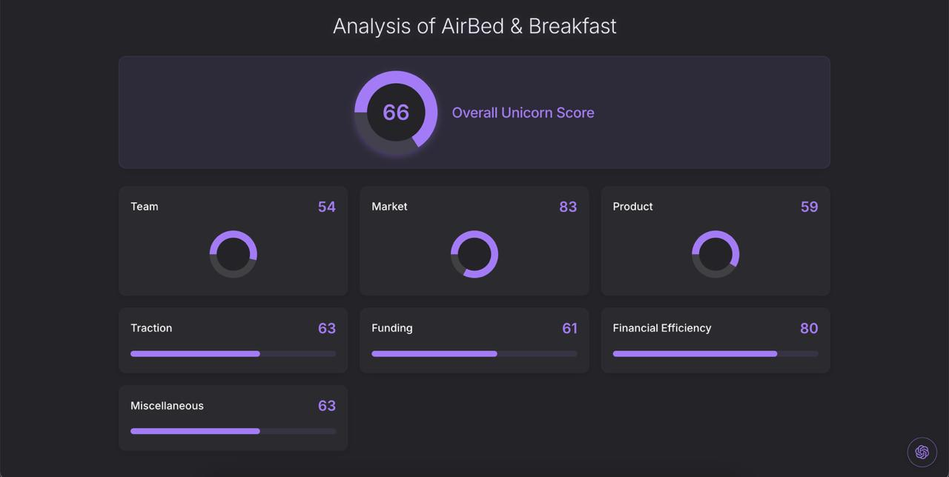
c
Startup Example 3
Dd
Dd
Ddd

Slide 13




Titel
What makes us…
Sophisticated Metrics
Highly Relevant Data Sources
Automated Email Service
Interactive Chatbot
…stand
Out from the rest

